Slide 1
Big Data Architecture and Governance
Individual Project |Tesla
Aaradhy Sharma

Slide 2
1. Selection Assignment

Slide 3
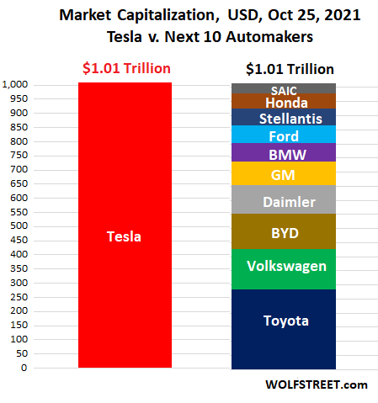
Tesla
Industry: Automotive, and energy generation and Storage
History/Background:
Tesla initially known as Tesla Motors was founded in 2003 by Martin Eberhard and Marc Trepanning in San Carlos.
The name tesla comes after a Genius Inventor Nikola Tesla who is known for his discoveries and invention in the field of electricity
Elon Musk join Tesla in 2004 and has become head of the chairman.
Tesla currently has the highest market cap of all car manufacturer

Slide 4
Issue Name: Quality Assurance
Tesla Currently facing Quality Assurance issues with the production of its cars such as model 3, Model X, Model Y, and new Model S Plaid
With the Help of Big data this process can be streamlined.
Such as real time monitoring of cars like how oftem service are require maintenance downtime, software update, issues etc
Doing predictive analysis for example tesla is manufacturing its own chipset using predictive analysis several checks can be avoided.

Slide 5
Impact Statement Guide
The purpose of this project is to improve Tesla Quality Assurance and help in keeping up with future demand

Slide 6
Issue Name: Battery Lifecycle
Along with Car manufacturing Tesla is also Dealing with Battery manufacturing and energy Storge as well Installing there Charging plant In the US, Eu, and China
Currently there is a big issue with battery Life as over a long period of time battery life is said to deteriorate
Using Big Data, we can predict battery deterioration get data from users on its usage. And improve the overall lifecycle.

Slide 7
Impact Statement Guide
The purpose of this project is to improve the overall battery lifecycle of all tesla cars and other products.

